Slide 1





Encoder Decoder with Applications

Slide 2

PRESENTATORS
Course Name : Digital Logic And Circuits
Course Instructor : Md. Shahariar Parvez
Section : K
ID | Name
22-47010-1 | MD. JAHID HASAN
22-47018-1 | FARJANA YESMIN OPI
22-47019-1 | MD. ABU TOWSIF

Slide 3
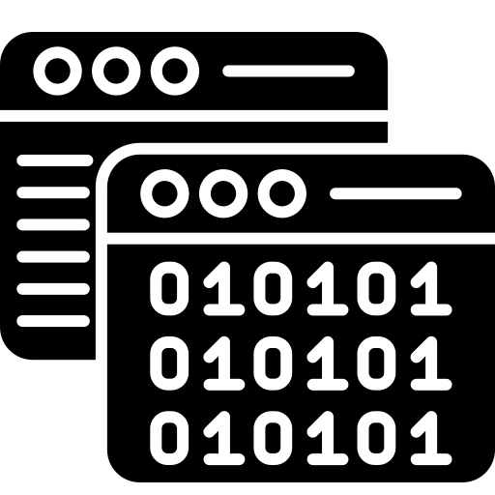

TABLE OF CONTENTS
1
Introduction
8
Encoder
2
Objective
9
Types of Encoder
3
Decoder
10
Diagram
4
Types of Decoder
11
Applications
5
Diagram
13
Emerging Trends
17
Conclusion
6
Applications
16
Discussion

Slide 4
01
INTRODUCTION
In the digital age, where information is paramount, understanding the processes that govern data transformation is crucial. This presentation delves into the fundamental concepts of encoding and decoding, shedding light on their roles in shaping the way information is handled across diverse applications.
Throughout this session, we will demystify the functionality of encoders and decoders, examining their applications in communication systems, digital electronics, and multimedia. Join us as we navigate through the intricacies of these core components, unraveling their significance and impact in the landscape of modern technology.
Let's begin our exploration of Encoder, Decoder, and the profound influence they exert on the processing of information in our interconnected world."

Slide 5
02
OBJECTIVE
The primary objectives of our presentation are to provide a comprehensive understanding of the core concepts of encoding and decoding, exploring their fundamental roles in information processing. We aim to delve into the intricacies of various types of encoders and decoders, such as sequential, priority, binary, and more, elucidating their distinctions and practical applications. Our exploration will extend to real-world scenarios, particularly in communication systems, digital electronics, and multimedia, showcasing the versatility and significance of these components. Additionally, we will discuss the challenges faced in encoder and decoder technology, offering insights into potential solutions. Moreover, our presentation will touch upon emerging trends and technologies, providing a glimpse into the future of information processing

Slide 6
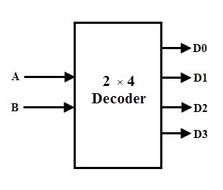
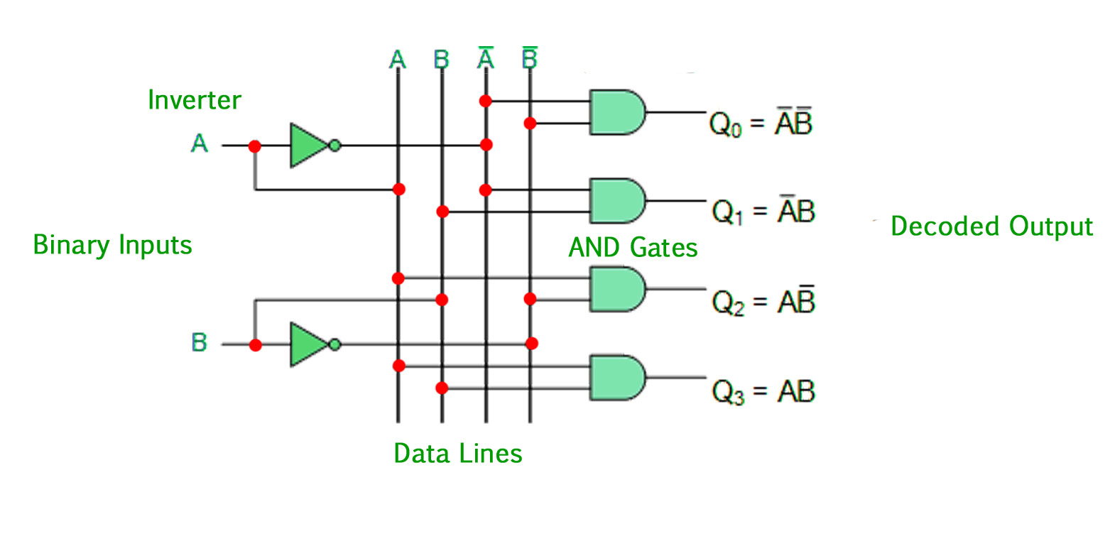

03
DECODER
A decoder is a logic circuit that accepts a set of inputs which represents a binary number and activates the only output that corresponds to the input number.
▶ A decoder is a combinational circuit that converts binary information from n input lines to a maximum of 2n unique output lines. If the n -bit coded information has unused combinations, the decoder may have fewer than 2n outputs
▶ In other words, a decoder circuit looks at its inputs, determines which binary number is present there, and activates the specific output which corresponds to that number; all other outputs remain inactive.

Slide 7
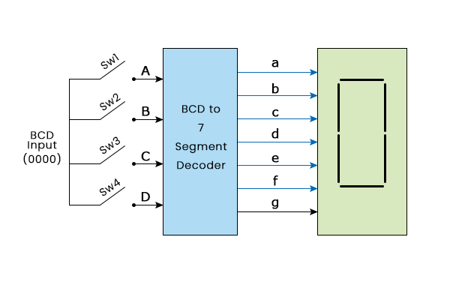

04
Types of DECODER
Decoders are used to identify or convert a particular code for example:
Binary to Octal (3-8 line decoders)
Binary to Hexadecimal (4-16 line decoders)
BCD to decimal (4-10 line decoders)
BCD to 7-segment display decoders
Decoders are widely used in memory system of computers.

Slide 8
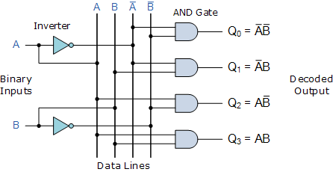
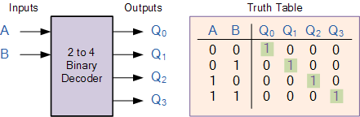

05
Diagram of 2to4 DECODER

Slide 9

06
Decoder Applications in Communication Systems and Digital Electronics
Multimedia Applications:
Decoders are indispensable in multimedia for the playback of compressed audio formats. Their primary role involves reversing the encoding process, allowing for faithful reproduction of the original audio content. In multimedia platforms, decoders contribute significantly to delivering high-quality and clear sound representation, ensuring an optimal audio experience for users across different content formats.
Case Study: Audio Decoding:
To illustrate the impact of decoders, we delve into a specific case study on audio decoding. This process involves converting encoded audio data back to its original format, guaranteeing listeners enjoy the best possible sound quality. Standards like MP3 decoding exemplify the critical role of decoders in audio content delivery, emphasizing their importance in providing an immersive and enjoyable audio experience.
Conclusion:
In conclusion, the applications of decoders in multimedia, highlighted by the case study on audio decoding, underscore their indispensable role in delivering high-quality and accurate content playback in the digital age.

Slide 10
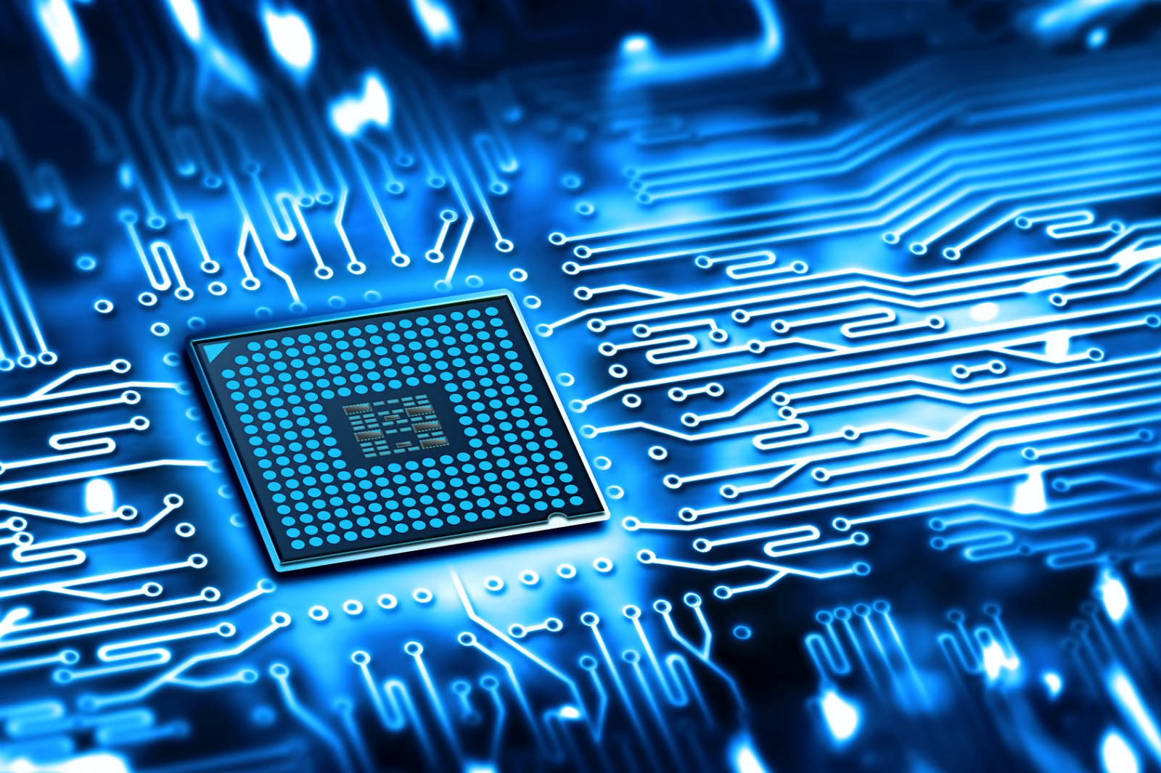

07
Decoder Applications contd.
Communication Systems:
In communication systems, decoders play a pivotal role in interpreting encoded data received from various sources. They reverse the encoding process, ensuring that the transmitted information is correctly understood by the receiving system. Decoders contribute to the seamless flow of data in communication protocols, allowing for accurate interpretation and utilization of transmitted information.
Digital Electronics:
Turning to digital electronics, decoders are integral in memory systems and address decoding. They facilitate the retrieval of stored data by decoding memory addresses, contributing to the efficiency of digital circuits. Decoders are fundamental in enabling precise data access and retrieval processes within digital systems, making them indispensable components in the realm of digital electronics.

Slide 11
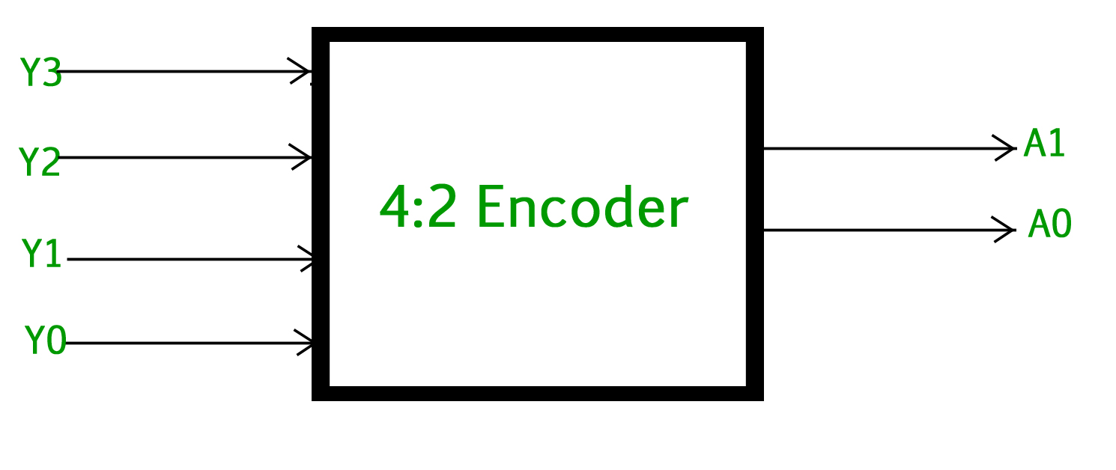
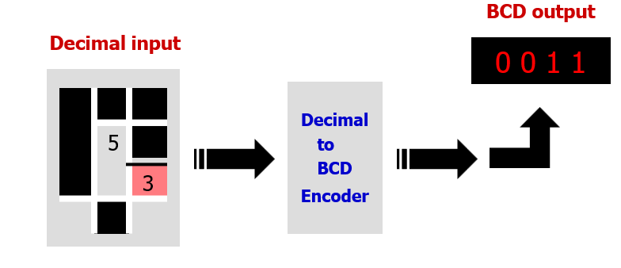
08
ENCODER
Is a digital circuit that produces a binary output code depending on which of its inputs are activated.
An encoder is a digital circuit that performs the inverse operation of a decoder.
▶ It has (or fewer) input lines and N-output lines. Out of input lines only one is activated at a given time and produces an output code, depending upon which input is activated.
▶ Encoding is a process of converting familiar numbers or symbols into coded format.

Slide 12
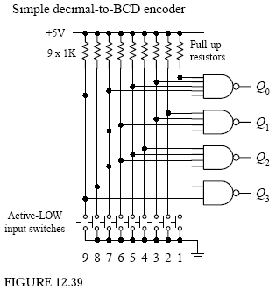
09
Types of ENCODER
Encoders are used to convert other codes to binary such as
Sequential Encoders
Priority Encoders
Decimal to BCD Encoder
Encoders are widely used in communication systems for data transmission and reception protocols, as well as in digital electronics for memory systems and address encoding. They find applications in diverse fields, including multimedia, industrial automation, robotics, medical imaging, automotive systems, aviation, and defense.

Slide 13
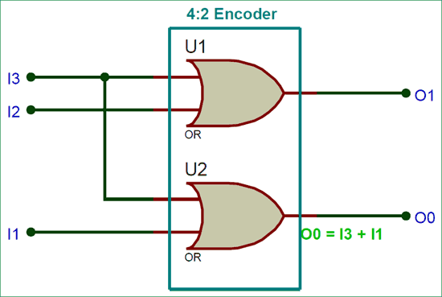
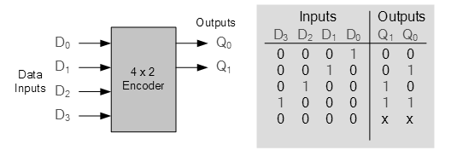
10
Diagram of 2to4 ENCODER

Slide 14
11
Encoder Applications in Communication Systems and Digital Electronics
Encoders serve as foundational components in both communication systems and digital electronics, playing diverse roles in facilitating seamless information flow and processing.
Communication Systems:
In communication systems, encoders are instrumental in data transmission protocols. They convert data into suitable formats for transmission, ensuring compatibility between sender and receiver systems. Additionally, encoders contribute to the reliability of communication by employing error detection and correction mechanisms, enhancing the integrity of transmitted information. This dual role makes encoders indispensable for maintaining efficient and error-free communication networks.
Conclusion:
From enabling smooth communication to enhancing digital electronic processes, encoders play a dual role in shaping the landscape of information processing. Their applications in both communication systems and digital electronics underscore their versatility and importance in modern technology.

Slide 15

12
Encoder Applications contd.
Expanding the scope of encoder applications, they prove instrumental in multimedia technologies, revolutionizing the way we interact with various forms of digital content.
Multimedia Applications:
In multimedia, encoders contribute to image and video compression techniques, optimizing storage and transmission. Moreover, they play a crucial role in audio encoding, ensuring efficient storage and high-quality playback. The widespread use of encoders in multimedia technologies enhances the overall user experience, making them indispensable in the creation and consumption of digital content.

Slide 16
13
Emerging Trends in Encoder and Decoder Technology
As technology continues to evolve, so do the trends in encoder and decoder technology. This section explores the cutting-edge developments shaping the future of these critical components in information processing.
1. Advancements in Encoding Algorithms:
- Ongoing research is driving advancements in encoding algorithms, aiming for more efficient and optimized data transformation processes.
- New algorithms may focus on reducing computational complexity, improving compression ratios, or enhancing real-time encoding capabilities.
2. Integration with Artificial Intelligence (AI):
- A notable trend is the integration of encoders and decoders with artificial intelligence and machine learning techniques.
- AI-enhanced algorithms are being developed to optimize encoding and decoding processes, allowing systems to adapt and learn from data patterns.

Slide 17
14
Emerging Trends in Encoder and Decoder Technology
3. Immersive Multimedia Experiences:
- In the multimedia realm, there's a growing emphasis on providing immersive experiences, leading to the development of more sophisticated encoding and decoding techniques.
- This includes advancements in virtual reality (VR) and augmented reality (AR) applications, where high-quality, low-latency encoding and decoding are crucial for seamless experiences.
4. *Security and Privacy Measures:
- With an increased focus on data security and privacy, emerging trends in encoder and decoder technology include the integration of robust encryption and decryption mechanisms.
- Techniques like homomorphic encryption may become more prevalent, allowing for secure processing of encoded data without the need for decryption.

Slide 18
15
Emerging Trends in Encoder and Decoder Technology
5. Edge Computing Integration:
- As edge computing gains prominence, encoder and decoder technology are adapting to meet the demands of processing data closer to the source.
- Edge-optimized algorithms are being developed to enable efficient encoding and decoding in edge computing environments, reducing latency and improving overall system performance.
In conclusion, the future of encoder and decoder technology is marked by exciting developments in algorithms, AI integration, immersive multimedia experiences, enhanced security measures, and adaptation to the evolving landscape of edge computing. Staying abreast of these emerging trends is crucial for harnessing the full potential of information processing in the years to come.

Slide 19
Discussion
16
As we delve into the discussion, it's evident that encoders and decoders form the bedrock of information processing, playing indispensable roles in communication systems, digital electronics, and multimedia applications. The versatile applications of encoders span from ensuring efficient data transmission in communication systems to optimizing digital circuits in electronics. On the other hand, decoders contribute significantly to the accurate interpretation and utilization of encoded data, whether in communication systems or digital electronics.

Slide 20
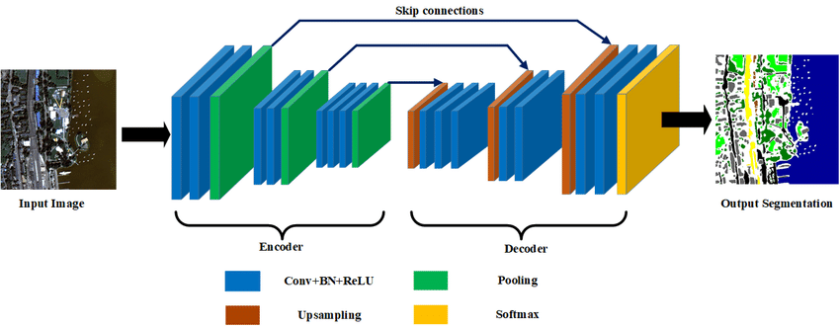
Conclusion
17
In conclusion, our exploration has underscored the critical importance of encoders and decoders in modern technology. From their fundamental roles in communication systems and digital electronics to their applications in multimedia, encoders, and decoders have proven to be versatile components. The case study on video compression and audio decoding exemplifies their real-world impact, contributing to the optimization of data storage and content delivery.

